Slide 1

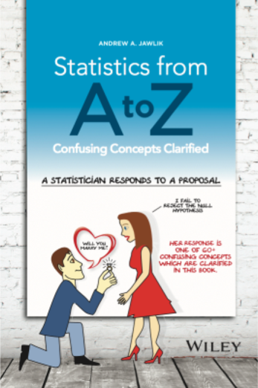
by Andrew A. Jawlik,
published by Wiley
www.statisticsfromatoz.com

Slide 2
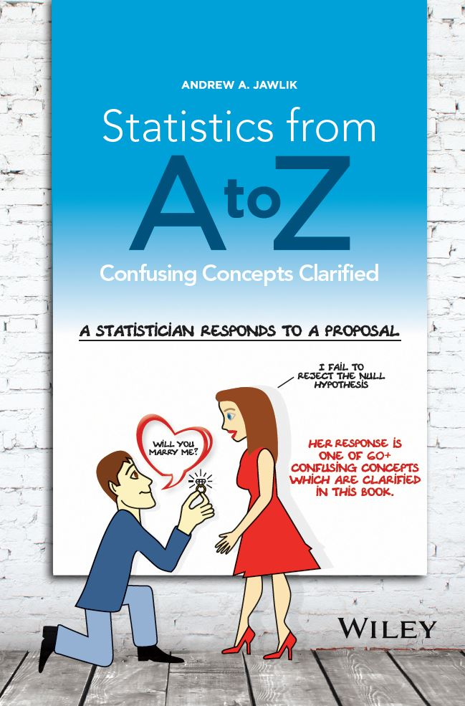




Book website: www. statisticsfromatoz.com
These Slides: www. statisticsfromatoz.com/Files
statisticsfromatoz.com/blog
Statistics Tip of the Week
You are not alone if you’re confused by statistics
statistics from a to z
@statsatoz
Channel: “Statistics from A to Z – Confusing Concepts Clarified”
17 videos currently --eventually as many as 50 or more on individual concepts in the book.

Slide 3




Comments on the YouTube videos,
which are based on content from the book.

Slide 4
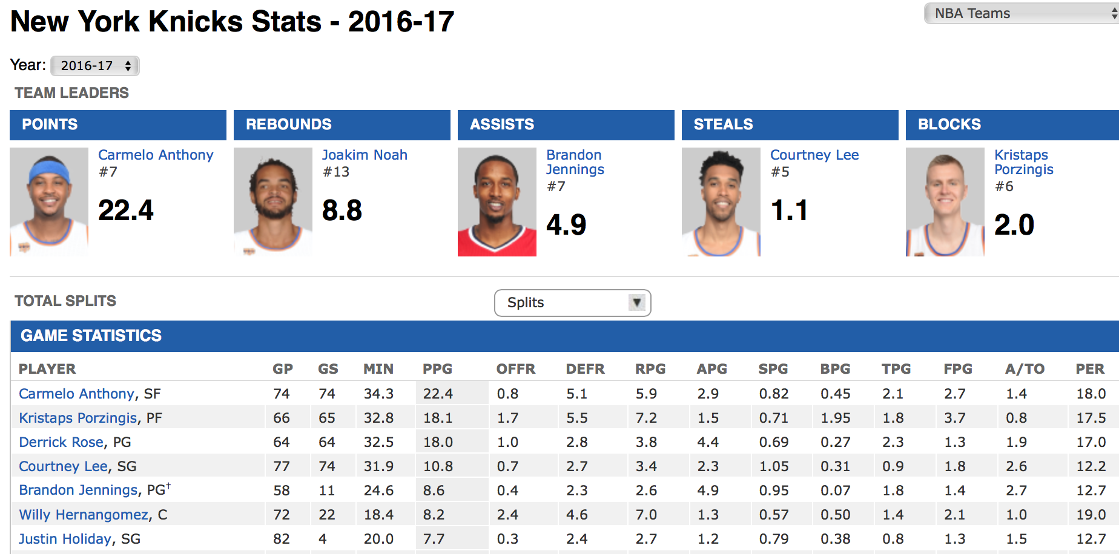
Today, we will not be talking about
Descriptive Statistics
in which ...
There is complete data on the Population or Process
We can use simple arithmetic to calculate Statistics directly from this data

Slide 5
We will be talking about
  Inferential Statistics:
    We have don’t have complete data for a Population or Process
    We have to take a Sample or Samples of data
    and then infer (estimate) statistical properties of the Population or Process from the Sample data.
  Statistics which involve
    Probabilities or
    Predictions

Slide 6

Statistics is confusing
-- even for intelligent, technical people

Slide 7

Statistics is confusing
-- even for intelligent, technical people
http://fivethirtyeight.com/features/not-even-scientists-can-easily-explain-p-values/

Slide 8
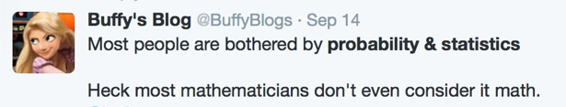
Statistics is confusing
-- even for intelligent, technical people
http://fivethirtyeight.com/features/not-even-scientists-can-easily-explain-p-values/

Slide 9

Statistics is confusing, because …
1. Statistics is based on probability.
“Humans are very bad at understanding probability. Everyone finds it difficult, even I do.”— David Spiegelhalter, University of Cambridge, professor of statistics

Slide 10
Statistics is confusing, because …
2. The language is confusing
  Different authors and experts use different words and abbreviations for the same concept.
    e.g. 5 or more different terms have been used for 1 concept:
variation
variability
dispersion
spread
scatter
for y = f(x)
y variable
dependent variable
outcome variable
response variable
criterion variable
effect

Slide 11
Statistics is confusing, because …
2. The language is confusing
  Different authors and experts use different words and abbreviations for the same concept.
  Conversely, one term can have 2 different meanings “SST” has been used for “Sum of Squares Total” and “Sum of Squares Treatment” (which is a component of Sum of Squares Total”)
  SST = SSR + SSE
  SST = SST + SSE ?

Slide 12
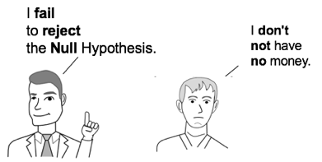
Statistics is confusing, because …
2. The language is confusing
  Different authors and experts use different words and abbreviations for the same concept.
  Conversely, 1 term can mean 2 different things
  Beyond the double negative -- a triple negative

Slide 13
Statistics is confusing, because …
1. Statistics is based on probability.
2. The language is confusing
3. Experts disagree on fundamental points
Whether to use an Alternative Hypothesis or not
Whether Confidence Intervals can overlap somewhat and still indicate a Statistically Significant difference.
Whether you can accept the Null Hypothesis

Slide 14
So, if you are confused by statistics:
You are not alone.

Slide 15
So, if you are confused by statistics:
You are not alone.
It’s entirely understandable that you would be confused.

Slide 16
So, if you are confused by statistics:
You are not alone.
It’s entirely understandable that you would be confused.
It’s not your fault.

Slide 17
How I came to write this book
I have an MS in math, but I was confused by the statistics in a Six Sigma black belt certification course.
  The books, Statistics for Dummies, Statistics in Plain English, and the Great Courses course in statistics were not sufficient help.
So, I began writing and illustrating my own explanations …

Slide 18
1-page summaries of key points
Concept Flow Diagrams
Cartoons, to enhance “rememberability”
Compare and Contrast Tables
Reproduced by permission of John Wiley and Sons
from the book Statistics from A to Z – Confusing Concepts Clarified

Slide 19
+
=
+
Six Sigma Black-Belt process statistics
443 pages

Slide 20
Planned for today
Hypothesis Testing
    5-step method
    Null and Alternative Hypothesis
    Reject the Null Hypothesis
    Fail to Reject the Null Hypothesis
4 Key Concepts in Inferential Statistics
    Alpha, α, the Significance Level
    p, p-value
    Critical Value
    Test Statistic
    How these 4 key concepts work together
Confidence Intervals
How Statistics can be used in Small Business

Slide 21

The Hypothesis Testing method can be performed in 5 steps.
5-Step Method For Hypothesis Testing
1. State the problem or question in the form of a Null Hypothesis and an Alternative Hypothesis.
2. Select a Level of Significance, Alpha (α).
3. Collect a Sample of data.
  4. Perform a statistical analysis (E.g. t-test, F-test, ANOVA) on the Sample data. This analysis calculates a value for p.
5. Come to a conclusion about the Null Hypothesis by comparing p to α.
  Reject the Null Hypothesis or Fail to Reject the Null Hypothesis.

Slide 22
The Null Hypothesis (symbol H₀) is the hypothesis of nothingness or absence. In words, the Null Hypothesis is stated in the negative.
This is not our usual way of thinking.
We would usually think of a question or a positive statement.
Question or Positive Statement | Equivalent Null Hypothesis (H₀)
Is there a Statistically Significant difference between the Means of these two Populations? | There is no difference between the Means of these two Populations.
Has there been a Statistically Significant change in the Standard Deviation of our Process? | There has been no change in the Standard Deviation of our Process from its historical value.
This experimental medical treatment has a Statistically Significant effect. | This experimental medical treatment has no effect.

Slide 23
------- Null Hypotheses ------
Reproduced by permission of John Wiley & Sons, Inc.
From the book, Statistics from A to Z – Confusing Concepts Clarified.
Implied: No “Statistically Significant” difference, change, or effect.
”Statistically Significant means that the calculated Probability of an Alpha Error (“False Positive” error) is less than the Significance Level (Alpha, a) which the tester has specified.

Slide 24
It is probably less confusing to state the Null Hypothesis as a mathematical comparison.
It must include an equivalence in the comparison symbol, using one of these: "=", "≥", or "≤" .
Avoid the confusing language of non-existence.
Instead of : "There is no difference between the Means of Population A and Population B."
The Null Hypothesis becomes a simple comparison:
μ_{A} = μ_{B}
Notes:
Mathematical comparisonma

Slide 25
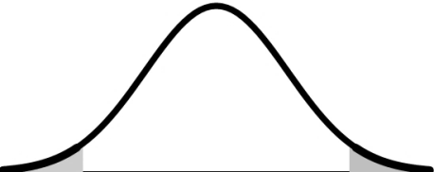
It is probably less confusing to state the Null Hypothesis as a mathematical comparison.
It must include an “equals” in the comparison symbol, using one of these: "=", "≥", or "≤" .
A Null Hypothesis which uses "=" would be tested with a 2-tailed (2-sided) test.
2-tailed test
α/2 = 2.5%
α/2 = 2.5%
In a 2-sided test,
H₀: μ_{A} = μ_{B}

Slide 26
The Alternative Hypothesis (H_{A} or H₁) is the opposite of the Null Hypothesis (H₀) – and vice versa.
In a 2-sided test,
H₀: μ_{A} = μ_{B,}
so
H_{A}: μ_{A} ≠ μ_{B}
Notes:
iis

Slide 27
But, we may not be interested in just whether or not there is a (Statistically Significant) difference.
We may be interested in whether there is a difference in a particular direction (greater than or less than).
E.g. We own a business which makes light bulbs.
We maintain that our light bulbs last 1,300 hours or more.
We would then use "≥" or "≤ " instead of "=" in the Null Hypothesis. E.g.
H₀: μ ≤ 1300 hours, or μ ≥ 1300 hours
But, how do we determine which?

Slide 28
If "=" is not to be used in the Null Hypothesis, start with what you maintain and would like to prove.
The Alternative Hypothesis is also known as the
"Maintained Hypothesis".

Slide 29
If "=" is not to be used in the Null Hypothesis, start with what you maintain and would like to prove.
The Alternative Hypothesis is also known as the
"Maintained Hypothesis".
If "=" is not to be used in the Null Hypothesis, start with the Alternative Hypothesis.

Slide 30
If "=" is not to be used in the Null Hypothesis, start with what you maintain and would like to prove.
The Alternative Hypothesis is also known as the
"Maintained Hypothesis".
If "=" is not to be used in the Null Hypothesis, start with the Alternative Hypothesis.
For example,
  We maintain that the Mean lifetime of the lightbulbs we make is more than 1,300 hours.
  H_{A}: µ > 1,300
  This is our Alternative Hypothesis.

Slide 31
The Null Hypothesis states the opposite of the Alternative Hypothesis.
  If we start with this Alternative Hypothesis:
  Alternative Hypothesis, H_{A}: µ > 1,300
That gives us this Null Hypothesis:
Null Hypothesis, H₀: µ ≤ 1,300
Remember that the Null Hypothesis must have an equals in its formula. (It must have “=“ , “≤” , or “≥”).

Slide 32
The Null Hypothesis always has an “equals” in the comparison symbol.
The Alternative Hypothesis never does.
Null Hypothesis | Alternative Hypothesis
= | ≠
> | <
< | >

Slide 33
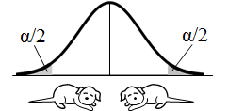
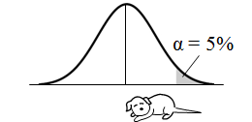
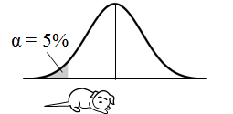
The Alternative Hypothesis points in the direction of the Tail of the test
Comparison Symbol |  | Tails of the Test
H_{A} | H₀
≠ | = | 2-tailed
> (points right) | ≤ | Right-tailed
< (points left) | ≥ | Left- Tailed
and you need to tell the direction of the tail to your spreadsheet or software

Slide 34
The last step in Hypothesis Testing is to either
  - "Reject the Null Hypothesis" if p ≤ α, or
  - "Fail to Reject the Null Hypothesis if p > α.
Null Hypothesis: There is no difference, change, or effect
Reject the Null Hypothesis: There is a difference, change or effect.
Fail to Reject the Null Hypothesis: There is no difference, change or effect.

Slide 35
Reject the Null Hypothesis
The Null Hypothesis states that there is no difference, no change, or no effect.
So, to Reject the Null Hypothesis is to conclude that there is a difference, change, or effect.

Slide 36

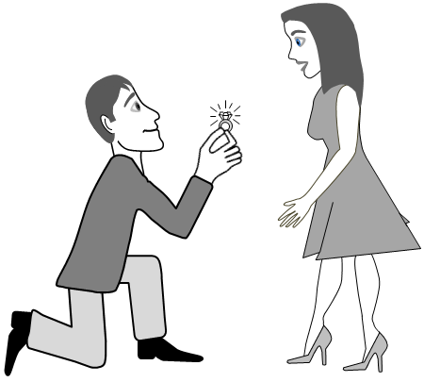
A Statistician Responds to a Marriage Proposal
I Reject the Null Hypothesis.
I Reject the Null Hypothesis.
Will you marry me?
Will you marry me?

Slide 37

A Statistician Responds to a Marriage Proposal
I Reject the Null Hypothesis.
Yes! The Null Hypothesis means “no change” So “Reject” means "Yes"!
I Reject the Null Hypothesis.
Will you marry me?
Will you marry me?

Slide 38

Fail to Reject the Null Hypothesis
The Null Hypothesis states that there is no difference, change or effect.
“Fail” and “Reject” cancel each other out, leaving the Null Hypothesis in place as the conclusion drawn from the test.
I Fail
to Reject
the Null
Hypothesis.
X
I Fail
to Reject
the Null
Hypothesis.
the Null
Hypothesis
X

Slide 39
Fail to Reject the Null Hypothesis
Another way to look at it:

Slide 40
Fail to Reject the Null Hypothesis
Practically speaking, it is OK to act as if you Accept the Null Hypothesis.
If we Fail to Reject the Null Hypothesis, we don’t say the results of the test are inconclusive.
We act as if we Accept the Null Hypothesis
And some expert say that we can come right out at say that we Accept the Null Hypothesis.

Slide 41
A Statistician Responds to a Marriage Proposal
I Fail to Reject the Null Hypothesis.
I Reject the Null Hypothesis.
Will you marry me?
Will you marry me?

Slide 43
A Statistician Responds to a Marriage Proposal
I Fail to Reject the Null Hypothesis.
Oh No! The Null Hypothesis means “no change” So “ Fail to Reject” means ”No"!
Will you marry me?
Will you marry me?

Slide 44
Planned for today
Hypothesis Testing
    5-step method
    Null and Alternative Hypothesis
    Reject the Null Hypothesis
    Fail to Reject the Null Hypothesis
4 Key Concepts in Inferential Statistics
    Alpha, α, the Significance Level
    p, p-value
    Critical Value
    Test Statistic
    How these 4 key concepts work together
Confidence Intervals
How Statistics can be used in Small Business

Slide 45
Concept Flow Diagram: Alpha, p, Critical Value and Test Statistic – how they work together
Reproduced by permission of John Wiley and Sons, Inc.
from the book Statistics from A to Z – Confusing Concepts Clarified

Slide 46
Compare and Contrast Table:
Alpha, p, Critical Value and Test Statistic
 | Alpha, α | p |  | Critical Value of Test Statistic | Test Statistic value
What is it? | a Cumulative Probability |  |  | a value of the Test Statistic
 | an area under the curve of the Distribution of the Test Statistic |  |  | a point on the horizontal axis of the Distribution of the Test Statistic
How is it pictured?
Boundary | Critical Value marks its boundary | Test Statistic value marks its boundary |  | Forms the boundary for Alpha | Forms the boundary for p
How is its value determined? | Selected by the tester | area bounded by the Test Statistic value |  | boundary of the Alpha area | calculated from Sample Data
Compared with | p | α |  | Test Statistic Value | Critical Value of Test Statistic
Statistically Significant/ Reject the Null Hypothesis if | p ≤ α |  |  | Test Statistic ≥ Critical Value e.g., z ≥ z-critical
Reproduced by permission of John Wiley and Sons, Inc.
from the book Statistics from A to Z – Confusing Concepts Clarified

Slide 47
p is the probability of an Alpha (“False Positive”) Error.
Reproduced by permission of John Wiley and Sons
from the book Statistics from A to Z – Confusing Concepts Clarified

Slide 48
Where does the value of p come from?
From the Sample data together with a Test Statistic Distribution.

Slide 49
What is a Test Statistic?
There are 4 commonly-used Test Statistics: z, t, F, and χ²
Each has its own Probability Distribution, so that, for any value of the Test Statistic, we know its Probability.
Or, for any value of a Probability, we know the value of the Test Statistic with that Probability

Slide 50
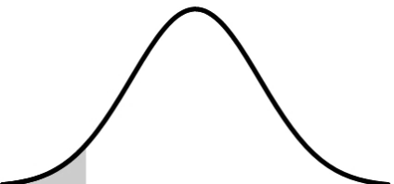
Test Statistic Distribution (cont.)
The Probability Distribution
of a Test Statistic
95%
5%
z
z = 1.645
And we also know the Cumulative Probability of a range of values of the test statistic. This is the area under the curve above those values.
p is one such Cumulative Probability

Slide 51
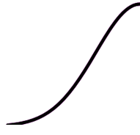
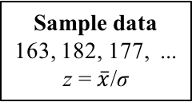
p is calculated by a statistical test, using the Sample data and a Test Statistic Distribution
Sample data
163, 182, 177, ...
z = $\overline{x}$/σ
z = 1.2
p = 11.5%
z
z
1.2
1.2
(The statistical test uses the Sample data to calculate a value for the Test Statistic.)
(Plot it on the horizontal axis of the Probability Distribution of the Test Statistic)
(Calculate the Cumulative Probability from that point outward)
z = 1.2 is the Test Statistic value. It is a point value on the Test Statistic axis.
p = 11.5% is the p-value associated with z = 1.2. It is a Cumulative Probability represented as an area under the curve of the Probability Distribution.

Slide 52


What have we learned so far?
(concept flow diagram version)
A Cumulative Probability
pictured as an area under the curve
a numerical value
pictured as a point on the horizontal (t) axis
marks the boundary of
Test Statistic value
(calculated from Sample data)
p-value, p
(start here)
is the area under the curve bounded by the
(close-up of the right tail of the curve)

Slide 53
What have we learned so far?
(compare-and-contrast table version)
 |  | p |  |  | Test Statistic value (e.g. t)
What is it? |  | a Cumulative Probability |  |  | a value of the Test Statistic
How is it pictured? |  | an area under the curve of the Distribution of the Test Statistic |  |  | a point on the horizontal axis of the Distribution of the Test Statistic
Boundary |  | Test Statistic value marks its boundary |  |  | Forms the boundary for p
How is its value determined? |  | area bounded by the Test Statistic value |  |  | calculated from Sample Data

Slide 54
Alpha, α, is the Level of Significance.
It is the highest value for p which we are willing to tolerate and still call the result of the test “Statistically Significant.”
10%
Probability
of α Error
Not Statistically Significant
α = 5%
Statistically Significant
0%

Slide 55
Alpha, α, is the highest value for p which we are willing to tolerate and still call the result of the test “Statistically Significant.”
10%
p = 8%
p > α: Not Statistically Significant
Probability
of α Error
α = 5%
0%
10%
α = 5%
Probability
of α Error
p < α: Statistically Significant
p = 4%
0%

Slide 56

Where does the value of Alpha come from?
α is selected by the person performing the test.
(This is Step 2 of the 5-step method for Hypothesis Testing.)
Most commonly, α = 5% is selected.
α is called the Level of Significance.
It is 100% - the Level of Confidence.
I want to be 95% confident of avoiding an Alpha Error.
So, I'll select α = 5%.
Reproduced by permission of John Wiley and Sons
from the book Statistics from A to Z – Confusing Concepts Clarified

Slide 57
If we get to select the value for Alpha, why wouldn’t we always select something like
α = 0.0001% ?
because, a lower Probability of an Alpha Error means a higher Probability of a Beta Error
from the book Statistics from A to Z – Confusing Concepts Clarified

Slide 58
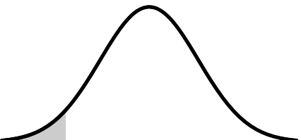
Alpha, α
I select
α = 5%
and
and
right-tailed
α = 5%
Test Statistic Distribution
Critical Value
Reproduced by permission of John Wiley and Sons, Inc.
from the book Statistics from A to Z – Confusing Concepts Clarified
The value for Alpha is selected by the tester
That value is plotted as a Cumulative Probability – a shaded area under the curve of the Test Statistic Distribution
The boundary of that area is calculated to be the Critical Value

Slide 59
Adding the information about Alpha and the Critical Value (we’re almost done):
 | Alpha, α | p |  | Critical Value of Test Statistic | Test Statistic value
What is it? How is it pictured? | a Cumulative Probability |  |  | a value of the Test Statistic
 | an area under the curve of the Distribution of the Test Statistic |  |  | a point on the horizontal axis of the Distribution of the Test Statistic
Boundary | Critical Value marks its boundary | Test Statistic value marks its boundary |  | Forms the boundary for Alpha | Forms the boundary for p
How is its value determined? | Selected by the tester | area bounded by the Test Statistic value |  | boundary of the Alpha area | calculated from Sample Data
Reproduced by permission of John Wiley and Sons, Inc.
from the book Statistics from A to Z – Confusing Concepts Clarified

Slide 60

Alpha, α
(selected by us)
and the t-Distribution determine the value of
Critical Value
marks the
boundary of
are Cumulative Probabilities
are pictured as areas under the curve
are numerical values
are pictured as points on the horizontal (t) axis
marks the boundary of
Test Statistic value
(calculated from Sample data)
p-value, p
is the area under the curve bounded by the
Reproduced by permission of John Wiley and Sons, Inc.
from the book Statistics from A to Z – Confusing Concepts Clarified

Slide 61
And the final piece …
To determine the outcome of Hypothesis Test:
Compare p to α
Or compare the Test Statistic value to the Critical Value
These comparisons are statistically identical, because
  p and the Test Statistic value contain the same information
  α and the Critical value contain the same information

Slide 62
Acceptance and Rejection Regions
Accep-tance Region
Rejection Region
1 - α = 95%
α = 5%
z
z
aka Fail-to-Reject and Rejection Regions
Fail-to-Reject Region
Rejection Region
1 - α = 95%
α = 5%
z
z

Slide 63
Fail-to-Reject and Rejection Regions
Close-up of areas under the curve (right tail)
Fail-to-Reject Region:
α, the Rejection Region:
p:

Slide 64
If p > α, we Fail to Reject the Null Hypothesis
 | p > α (p extends into the Fail-to-Reject Region) t < t-critical
Null Hypothesis | Fail To Reject
Any difference, change, or effect observed in the Sample data is: | Not Statistically Significant
Areas under the curve (right tail)
Fail to Reject Region:
α, the Rejection Region:
p:
Reproduced by permission of John Wiley and Sons, Inc.
from the book Statistics from A to Z – Confusing Concepts Clarified

Slide 65
If p ≤ α, we Reject the Null Hypothesis
 | p > α (p extends into the Fail-to-Reject Region) t < t-critical | p ≤ α (p is entirely within the Rejection Region) t ≥ t-critical
Null Hypothesis | Fail To Reject | Reject
Any difference, change, or effect observed in the Sample data is: | Not Statistically Significant | Statistically Significant
Areas under the curve (right tail)
Fail to Reject Region:
α, the Rejection Region:
p:
Reproduced by permission of John Wiley and Sons, Inc.
from the book Statistics from A to Z – Confusing Concepts Clarified

Slide 66
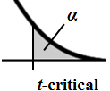
Alpha, α
(selected by us)
and the t-Distribution determine the value of
Critical Value
marks the
boundary of
are Cumulative Probabilities
are pictured as areas under the curve
are compared with each other
are numerical values
are pictured as points on the horizontal (t) axis
are compared with each other
marks the boundary of
Test Statistic value
(calculated from Sample data)
p-value, p
is the area under the curve bounded by the
Reproduced by permission of John Wiley and Sons, Inc.
from the book Statistics from A to Z – Confusing Concepts Clarified

Slide 67
 | Alpha, α | p |  | Critical Value of Test Statistic | Test Statistic value
What is it? How is it pictured? | a Cumulative Probability |  |  | a value of the Test Statistic
 | an area under the curve of the Distribution of the Test Statistic |  |  | a point on the horizontal axis of the Distribution of the Test Statistic
Boundary | Critical Value marks its boundary | Test Statistic value marks its boundary |  | Forms the boundary for Alpha | Forms the boundary for p
How is its value determined? | Selected by the tester | area bounded by the Test Statistic value |  | boundary of the Alpha area | calculated from Sample Data
Compared with | p | α |  | Test Statistic Value | Critical Value of Test Statistic
Statistically Significant/ Reject the Null Hypothesis if | p ≤ α |  |  | Test Statistic > Critical Value e.g., t > t-critical
Reproduced by permission of John Wiley and Sons, Inc.
from the book Statistics from A to Z – Confusing Concepts Clarified

Slide 68
Confidence Intervals is the other main method of Inferential Statistics

Slide 69

Here’s how we get from the selection of a value for Alpha to a Confidence Interval
I select
α = 5%
Critical Value
z = -1.960
Critical Value
z = +1.960
α/2 = 2.5%
α/2 = 2.5%
95%
z
0
We select a value for Alpha.
We place half that value under each tail of a Distribution of a Test Statistic
The boundary for that area under the curve is the Critical Value
The Critical Value is in units of the Test Statistic.

Slide 70


Here’s how we get from the selection of a value for Alpha to a Confidence Interval
I select
α = 5%
Critical Value
z = -1.960
Critical Value
z = +1.960
α/2 = 2.5%
α/2 = 2.5%
95%
z
0
x = σz + $\overline{x}$
x in centimeters
$\overline{x}$ = 175 cm.
We convert the Critical Value into units of the data (x).
Confidence Limit
170 cm.
Confidence
Interval
Confidence Limit
180 cm.
The results define the boundaries of the Confidence Interval.

Slide 71
There are pros and cons to using the Confidence Interval method of Inferential Statistics
Pros
Visual
Easy to Understand
If the CIs don’t overlap, there is a (Statistically Significant) difference, change, or effect
If they do overlap, most experts say there is no difference, change, or effect.
No confusing language like in the Null Hypothesis or “Fail to reject”.
Cons
Possibly inconclusive
Some experts say that there can be a small overlap and still be a Statistically Significant difference, change or effect.
In that case, you’d need to do a Hypothesis Test to make sure.
(So, maybe it’s better to just start with a Hypothesis Test?)

Slide 72
Planned for today
Hypothesis Testing
    5-step method
    Null and Alternative Hypothesis
    Reject the Null Hypothesis
    Fail to Reject the Null Hypothesis
4 Key Concepts in Inferential Statistics
    Alpha, α, the Significance Level
    p, p-value
    Critical Value
    Test Statistic
    How these 4 key concepts work together
Confidence Intervals
How Statistics can be used in Small Business

Slide 73
Some uses for Statistics
in Small Businesses
(and elsewhere)

Slide 74
Use t-tests when Comparing Means

Slide 75
The 1-Sample t-test compares the Mean of the Sample to a Mean which we specify.
The specified Mean can be an estimate, a hypothesis, a target, a historical value, etc.
We can test whether
  There is a (Statistically Significant) difference between the 2 Means (in either direction).
  Or whether μ_{specified} < μ_{sample} or μ_{specified} > μ_{sample}
Examples:
Has our average defect rate changed from the historical rate?
Do the lightbulbs we make exceed the 1,300 hour average lifetime we advertise?

Slide 76
The 2-Sample t-test compares the Means
of 2 Samples.
The two Samples are from different Populations or Processes.
E.g. we are testing the effectiveness of two treatments, A and B.
If there is a Statistically Significant difference between the Mean effectiveness of one treatment, i.e.,
μ_{A} ≠ μ_{B}
  we will buy the one with the higher score.
If not, i.e.,
μ_{A} = μ_{B,}
  we’ll buy the one that is more consistent (has smaller Variance).

Slide 77
The Paired t-test compares the Means of 2 Samples from the same test subjects.
2-Sample t-test |  |  |  |  |  |  | Paired t-test
Sample 1 Not trained n₁ = 6 |  |  | Sample 2 Trained n₂ = 5 |  |  |  | Before Training | After Training | Difference n = 5
J. Black | 72 |  | A. Conrad | 76 |  | K. Albert | 74 | 78 | +4
T. Gerard | 80 |  | J. David | 78 |  | P. Jacobs | 76 | 83 | +7
M. Lowry | 78 |  | W. Johns | 83 |  | T. Smith | 73 | 81 | +8
P. Mason | 74 |  | F. Lyons | 86 |  | R. Wang | 81 | 84 | +3
R. Vargas | 79 |  | M. White | 61 |  | D. Young | 78 | 86 | +8
B. Wilson | 70
Sample 1 and Sample 2 contain different test subjects
Examples:
Before and afters, or
For each website development contract compare hours bid to hours actual.

Slide 78
The F-test compares 2 Variances
In the previous example, let’s say there was no Statistically Significant difference in the Mean effectiveness of the two treatments (μ_{A} = μ_{B}).
We would then use the F-Test to determine if there is a Statistically Significant difference in their Variances. If so, we’ll buy the more consistent one (smaller Variance). If not, we’ll just buy the cheaper one.
Another example: We want to compare the Standard Deviation of our new, hopefully improved process with the previous process.

Slide 79
The Chi-Square Test for the Variance compares the Variance of a Sample of data to a specified Variance.
We specify the Variance. It could be a target, a historical value, an estimate or anything else.
For example, we may have a historical value for the Standard Deviation of an internal process. And we want to take some measurements to make sure we’re still operating within that value.
 | Compares | Analogous t-test
Chi-Square Test for the Variance | Variance of a Sample to a Variance we specify | 1-Sample
F-Test | Variances of 2 Samples | 2-Sample

Slide 80
Use the Chi-square test for Independence to determine if two categories are independent, or if they effect one another.
Example: does Gender have an effect on fruit juice preference?
How about ice cream flavor?

Slide 81
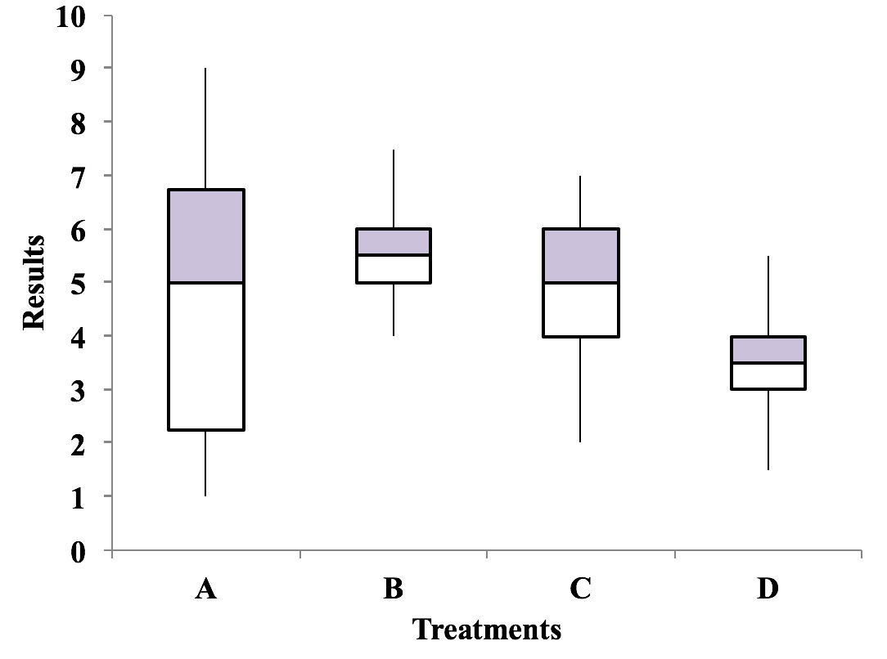
Use Boxplots to visually depict and compare Variation
The bottom of the box identifies the 25th percentile (25% of the data is below)
The line in the middle is the Median (50th percentile)
The top of the box is the 75th percentile
The line segments (the "whiskers") at the top and bottom extend to the highest and lowest values
Here, Treatment A has the highest value, but has a high Variance
B looks like the best choice.

Slide 82
Customer Polling and Proportion
Restaurant poll: more meat or more seafood menu items?
First responses:
16 meat (Proportion: 0.57)
12 seafood (Proportion: 0.43)
Sample Size: n = 28
How reliable is this information?
What’s the Margin of Error?
Is the Sample Size big enough?
If not, what Sample Size would be big enough?
The z Test Statistic can be used to provide the answers for 2 Proportions.
Use the Chi-Square Test for Independence for 3 or more Proportions.

Slide 83
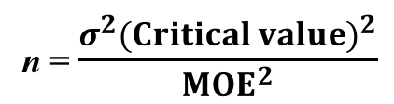
Sample Size
For Proportions for Count Data
n = (0.25) (z_{α/2})² / MOE²
where z_{α/2} = 1.96 for α = 5%, and MOE is the Margin of Error
For Continuous/ Measurement Data
n = $\frac{σ^{2}{(Critical value)}^{2}}{{MOE}^{2}}$

Slide 84
Control Charts
Upper and Lower Control Limits (CL and LCL are typically 3 Std. Deviations from the Center Line
In addition Run Rules define out of control conditions:. E.g
  6 consecutive points increasing or decreasing.
  8 consecutive points on one side of the Center Line

Slide 85
Use Regression to predict future values from a model.
Drop House Size due to p > 0,5; rerun the model to get …
Multiple Linear Regression Model (thousands of dollars):
House Price = -38.824 + (83.725 x Bedrooms) + (76.078 x Bathrooms)

Slide 86
Use the Chi-square test for Goodness of Fit
to compare plan to actual for multiple values.
Example: We are opening a new bar. For staffing purposes, we plan on the following distribution of percentages of customers by day of the week.
Our actual count of customers was:
Is there a Good Fit between our plan and the actual results?

Slide 87
E-mail: andrewajawlik@gmail.com
Book website: statisticsfromatoz.com
These Slides: statisticsfromatoz.com/Files
statisticsfromatoz.com/blog
Statistics Tip of the Week
You are not alone if you’re confused by statistics
statistics from a to z
@statsatoz
Channel: “Statistics from A to Z – Confusing Concepts Clarified”
17 videos currently --eventually as many as 50 or more on individual concepts in the book.

